Slide 1


6/8 OCTOBER 2020
BIARRITZ • LE BELLEVUE
BUSINESS ACCELERATOR FOR
DIGITAL MARKETING LEADERS
BUSINESS ∙ INSPIRATION ∙ NETWORKING
EXAMPLE OF TITLE PRESENTATION
#1to1Biarritz
one-to-one-biarritz.com

Slide 2
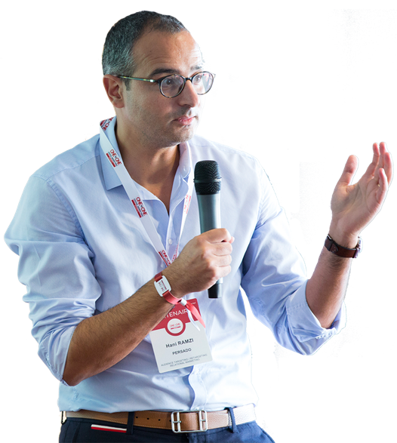
TITLE EXAMPLE
Subtitle exemple
Accenderat super his incitatum propositum ad nocendum aliqua mulier vilis, quae ad palatium ut poposcerat intromissa insidias ei latenter obtendi prodiderat a militibus obscurissimis.
Learn more

Slide 3
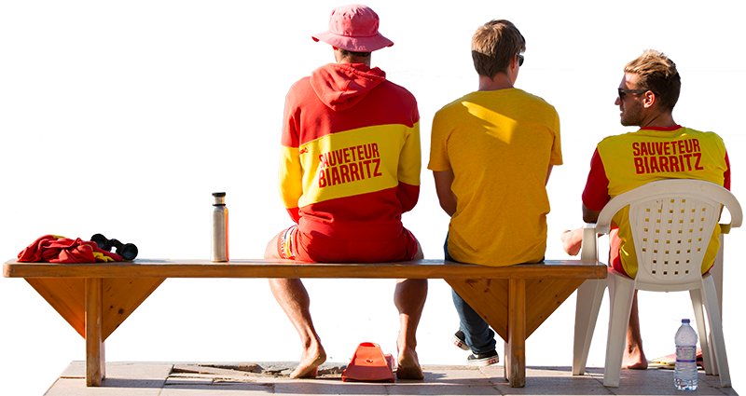
TITLE EXAMPLE
Subtitle exemple
Accenderat super his incitatum propositum ad nocendum aliqua mulier vilis, quae ad palatium ut poposcerat intromissa insidias ei latenter obtendi prodiderat a militibus obscurissimis.
Learn more

Slide 4





SLIDE EXAMPLE « STEPS »
Subtitle example
Accenderat super his incitatum propositu.
Accenderat super his incitatum propositu.
Accenderat super his incitatum propositu.
Accenderat super his incitatum propositu.

Slide 5






Subtitle example
SLIDE EXAMPLE « SKILLS »
Accenderat super
Accenderat super
Accenderat super
Accenderat super his incitatum propositu.
Accenderat super his incitatum propositu.
Accenderat super his incitatum propositu.
Accenderat super
Accenderat super
Accenderat super
Accenderat super his incitatum propositu.
Accenderat super his incitatum propositu.
Accenderat super his incitatum propositu.

Slide 6


EXAMPLE SLIDE « PARAGRAPH »
PARAGRAPH TITLE
Accenderat super his incitatum propositum ad nocendum aliqua mulier vilis, quae ad palatium ut poposcerat intromissa insidias ei latenter obtendi prodiderat a militibus.
Accenderat super his incitatum propositum ad nocendum aliqua mulier vilis, quae ad palatium ut poposcerat intromissa insidias ei latenter obtendi prodiderat a militibus obscurissimis.

Slide 7

Subtitle example
SLIDE EXAMPLE
« CONCLUSION »
Accenderat super his incitatum propositum ad nocendum aliqua mulier vilis, quae ad palatium ut poposcerat intromissa insidias ei latenter obtendi prodiderat a militibus.
Accenderat super his incitatum propositum ad nocendum aliqua mulier vilis, quae ad. ad nocendum aliqua mulier vilis, quae ad

Slide 8
Subtitle example
SLIDE EXAMPLE « HASHTAG »
#1to1Biarritz
one-to-one-biarritz.com

Slide 9

6/8 OCTOBER 2020
BIARRITZ • LE BELLEVUE
BUSINESS ACCELERATOR FOR
DIGITAL MARKETING LEADERS
BUSINESS ∙ INSPIRATION ∙ NETWORKING
SOPHIE LACELLE
Chef de marché
Sophie.lacelle@comexposium.com
Téléphone : +33 (0)1 76 77 13 90
#1to1Biarritz
one-to-one-biarritz.com

Slide 10











Elements icons :

Slide 11





Graphics elements :
i

Slide 12
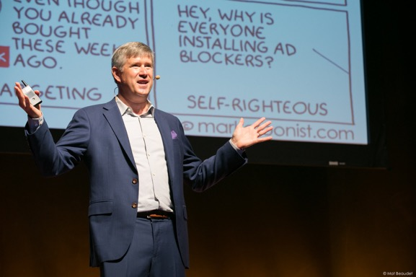
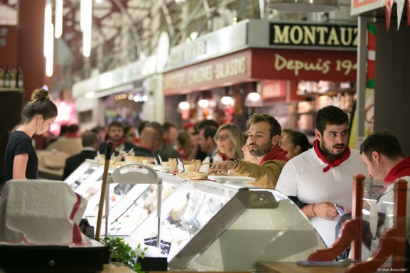
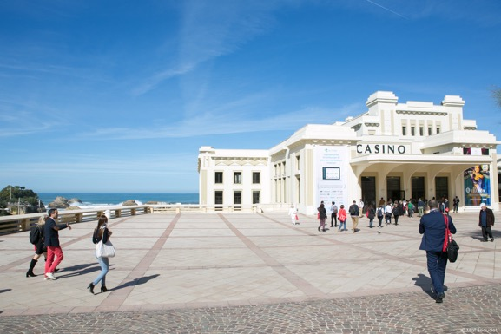
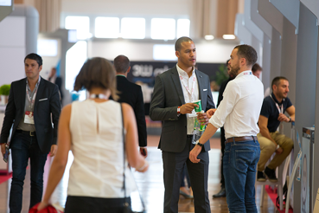
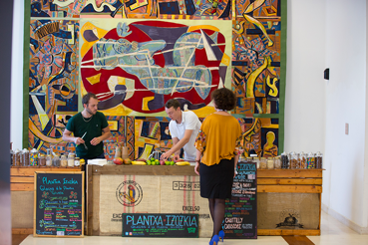
Available photos :

